Slide 1
Can LLMs solve compositional tasks? A study of out-of-distribution generalization
Yiqiao Zhong (UW Madison Statistics)
Peking Univ, June 5, 2025

Slide 2


Collaborators
Jiajun Song, BIGAI
Zhuoyan Xu, UW Madison
Paper: https://www.pnas.org/doi/10.1073/pnas.2417182122

Slide 3
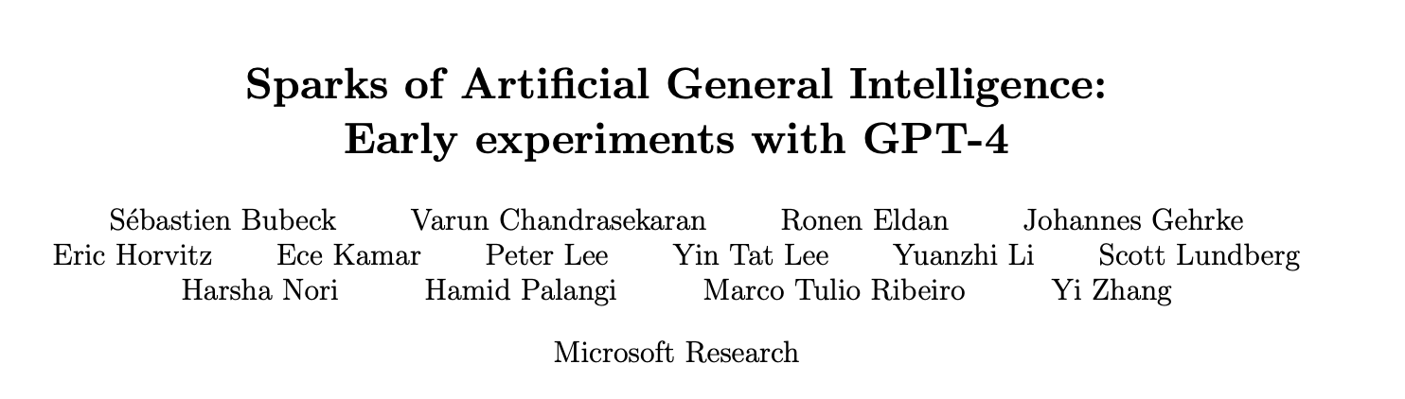

Are LLMs creative? Or are they a hype?
Two polarizing opinions
Sparks of artificial general intelligence
LLMs memorize facts, parrot the speech
Intriguing phenomena: Emergent abilities
Sudden emergence, sharp increase in accuracy
In-context learning (ICL)
Chain-of-thought (CoT)
Lack of scientific foundations
Overloading notions
Unclear model internals
Lack of clear measurements

Slide 4
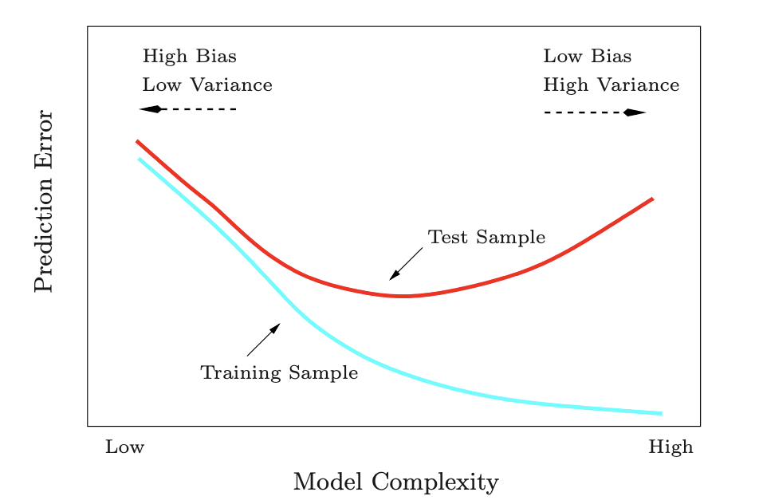
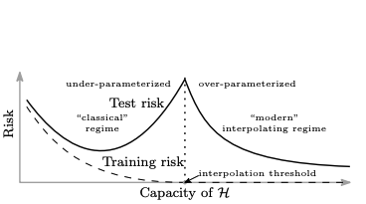
Does classical notions of generalization explain?
ESL: Bias-variance tradeoff
Belkin et. al. 2019: Double descent
Lack of performance measures on Novel task

Slide 5
Compositions and OOD generalization
Out-of-distribution (OOD) generalization:
In-distribution (ID) generalization:
Compositions and “reasoning”: benefits of multiple layers
Holy grail
How do LLMs represent composition?
When do we expect emergence?
Why do LLMs achieve OOD generalization?

Slide 6
Teaser: Evidence of OOD generalization
Realistic Task: “Symbolized language reasoning”
Indirect object identification (IOI)
(normal)
“Then, Henry and Blake had a long argument. Afterwards Henry said to” →Blake
(symbolized)
“Then, &^ and #$ had a long argument. Afterwards &^ said to” → #$
In-context learning (ICL)
(normal)
“baseball is sport, celery is plant, sheep is animal, volleyball is sport, lettuce is” → plant
(symbolized)
“baseball is $#, celery is !%, sheep is &*, volleyball is $#, lettuce is” → !%
See Rong 2021, Wang et. al., ICLR 2023, Pan et. al., ACL 2023

Slide 7
Draw 100 test prompts for each subtask, two versions (normal as ID, symbolized as OOD)
IOI:
ICL: where
Calculate Acc in multiple-choice form, random guess 1/2 (IOI), 1/3 (ICL has 3 categories)

Slide 8
Synthetic Task: “Learning copying with a simple Transformer”
Vocabulary size 64, sequence len 64, draw i.i.d. tokens from a power law distribution to form “noisy background” in a prompt
Sample segment len uniformly, and then sample a segment of len
Place two copies of at random non-overlapping locations in the prompts. Prompt format
See Olsson et. al., 2022

Slide 9
OOD data
Token distribution changed from power law to uniform
Length of repeating segment changed from {10, 12, … 19} to 25
Model: minimal Transformer, 2-layer and 1-head
No MLP, standard architecture (residual connection, LayerNorm, RoPE, dropout)
Trained on fresh samples (one-pass setting), autoregressive, standard technique (AdamW)
Simple for rule-based algorithms, but hard for classical general-purpose ML methods (n-gram models, hidden Markov models)

Slide 10
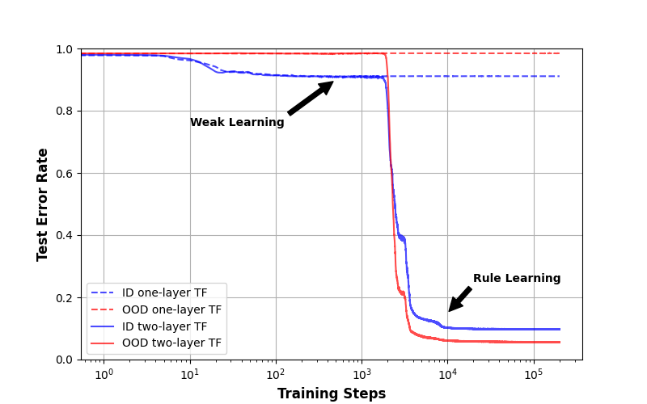
Weak learning phase: rely on simple statistics of ID data and fail to generalize OOD
Rule-learning phase: two-layer TF learns the rule of copying from ID data

Slide 11
What do we learn?
Benefits of composition: two layer >> one layer
Emergence of learning copying
OOD generalization reasonably well
Goal of this talk:
Geometric (mechanistic) insights via experiments

Slide 12
A Primer on Transformer

Slide 13
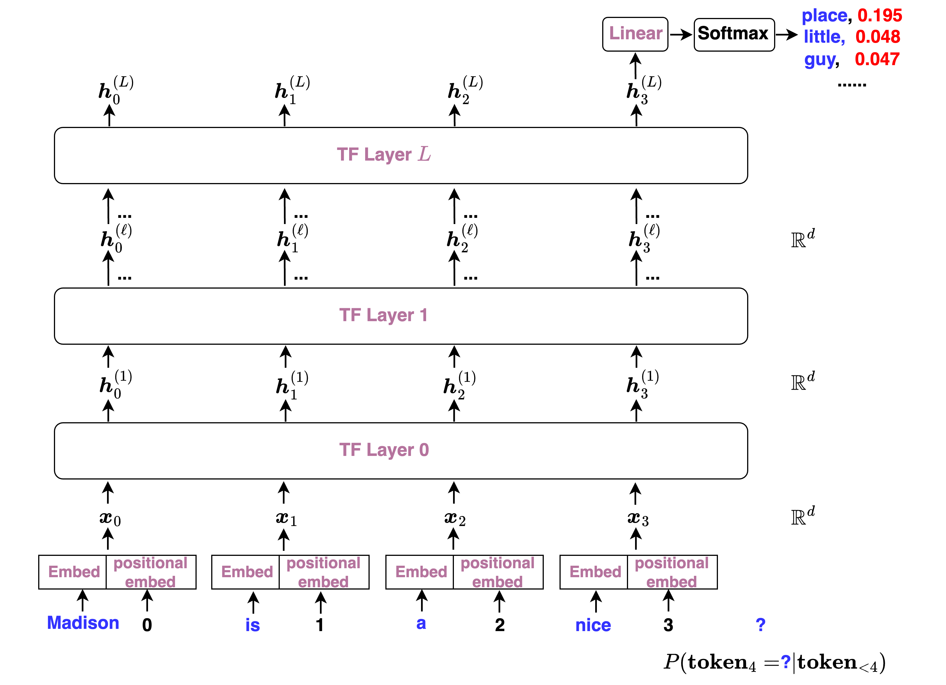
Next token prediction
Final embeddings
Hidden states / Embedding
Composing Self-attention blocks
Tokenizing input text

Slide 14
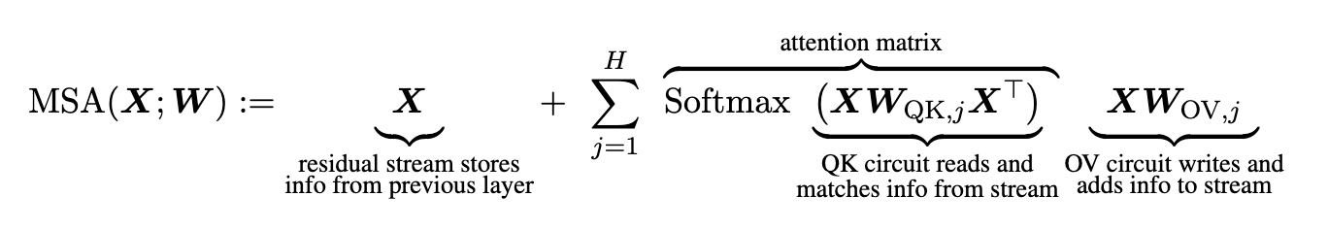
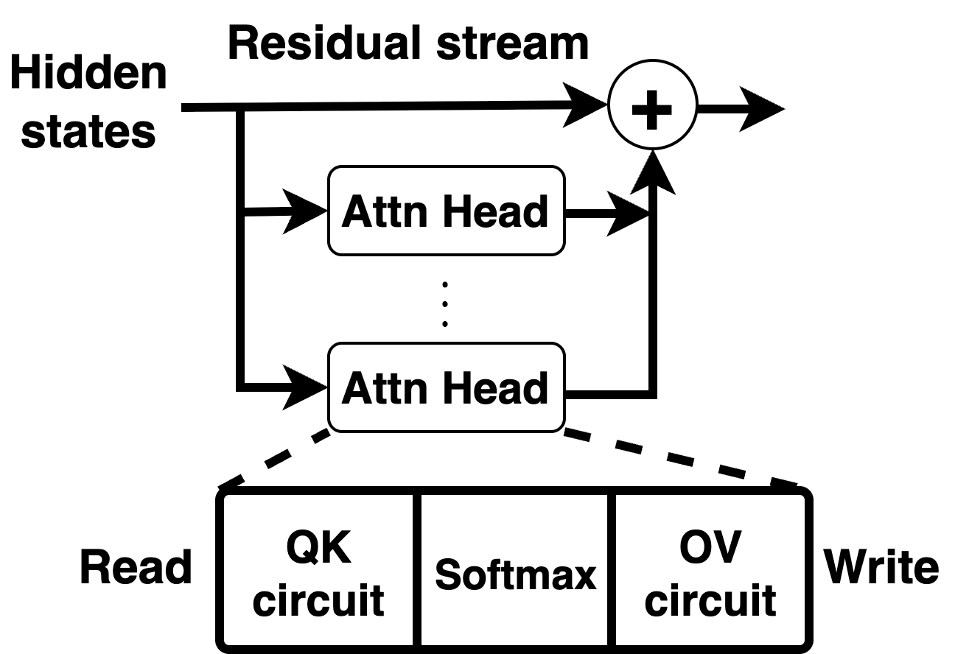
A simple intro to self-attention
Input or hidden states , is seq length, is embed dim
Attention matrix: similarities of hidden states between pairs of hidden states
See Elhage et. al., 2021

Slide 15
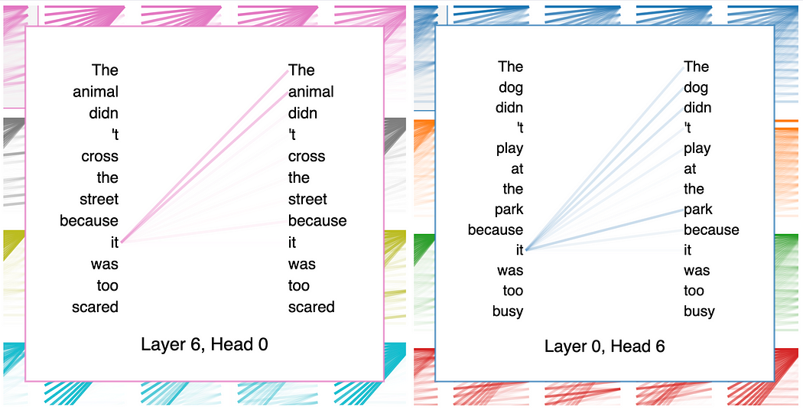
GPT-2 example, Credit: https://mlops.community/
Credit: https://mlops.community/explainable-ai-visualizing-attention-in-transformers/

Slide 16
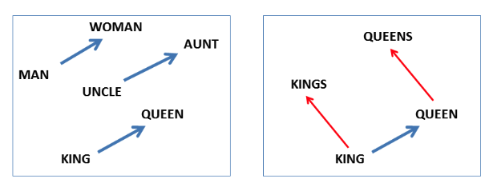
What do hidden states represent?
In pre-Transformer age, word meaning is decomposed into vectors of latent concepts/factors
Classical stats: PCA and factor analysis, e.g., latent factor that drives stock market or gene expression or network community structure
Word embedding, “gender” factor + “royalty” factor
See Mikolov et. al., 2013

Slide 17
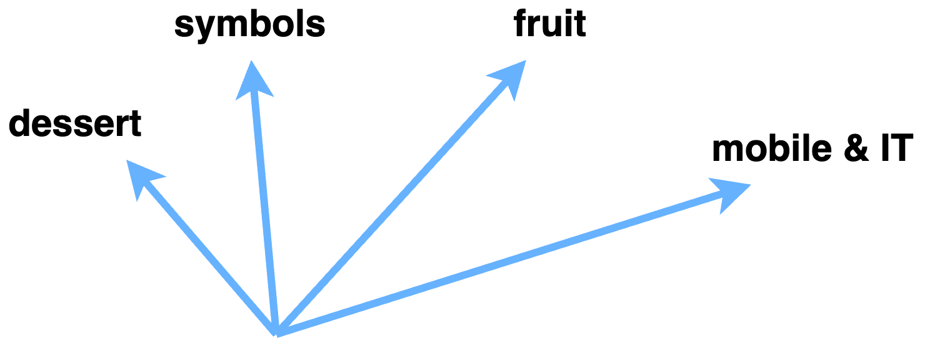
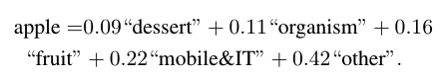
Linear representation hypothesis
Dictionary learning: find of vectors as “base concepts”
Dictionary size much larger than embedding dimension
Then hidden state vector is a sparse linear combination of “base concepts” (feature superposition)
Anthropic and OpenAI’s interpretability research

Slide 18
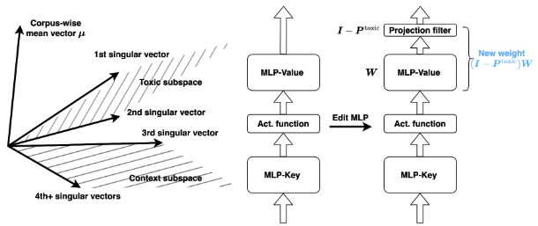
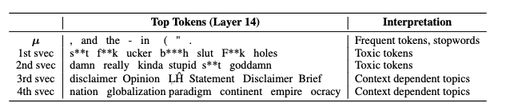
Linear representation hypothesis
A large literature on alignment, model editing [UDHZH, 2024]

Slide 19
Emergence of Subspace Matching

Slide 20
Synthetic experiment “Learning copying with a simple Transformer”
2-layer 1-head no-MLP TF:
1st layer
What compositional structure enables copying?
2nd layer

Slide 21
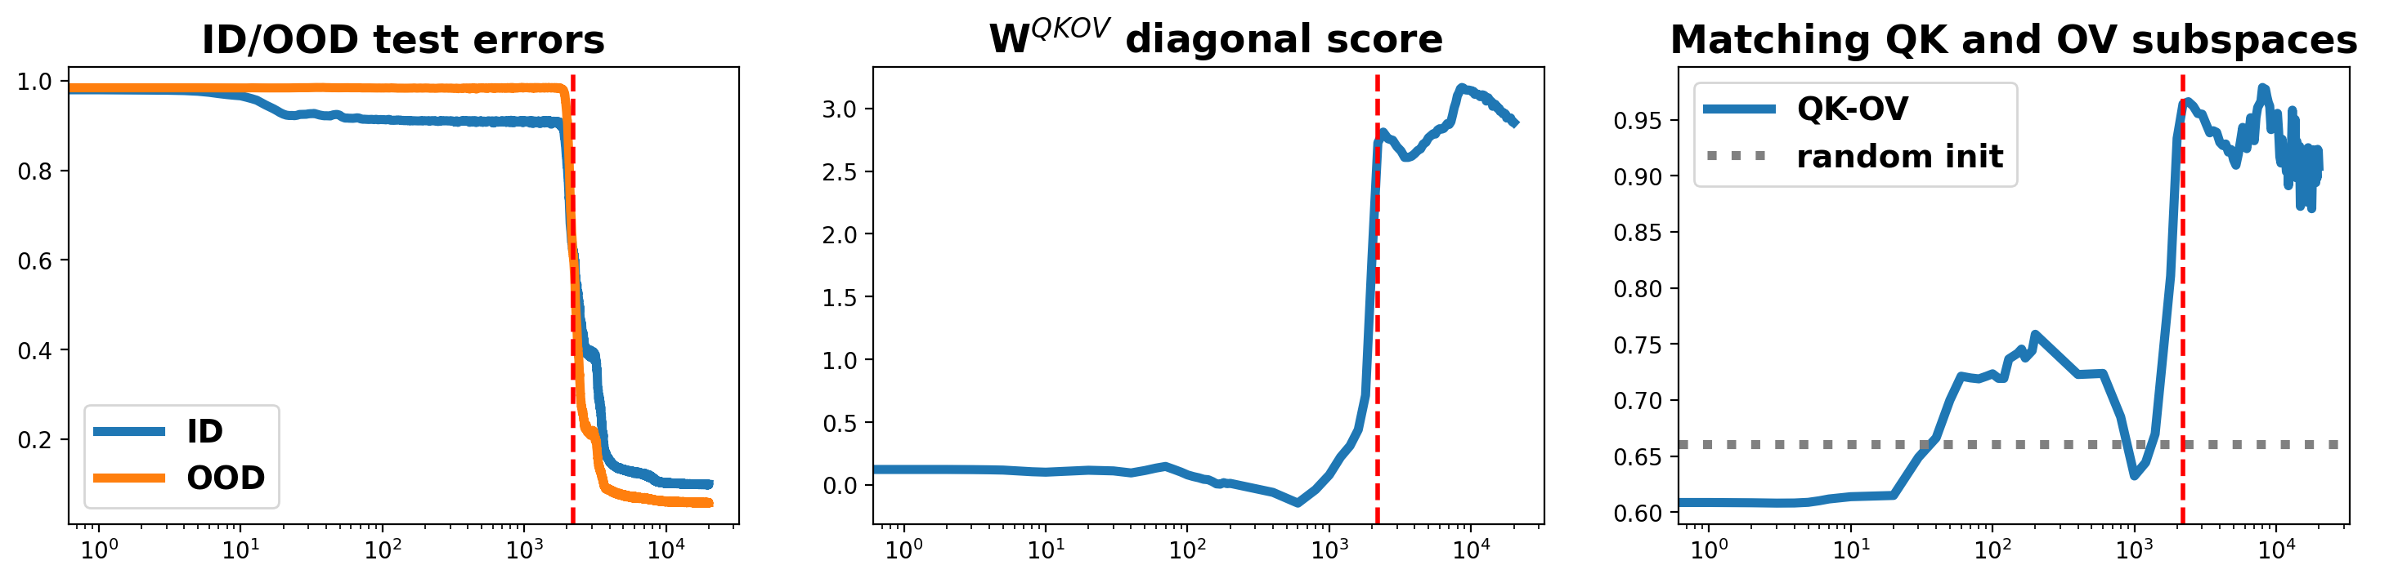
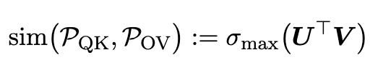
Diagonal score measures normalized avg diagonal entries of
Subspace matching: generalized cosine sim between two principal subspaces ( ):

Slide 22
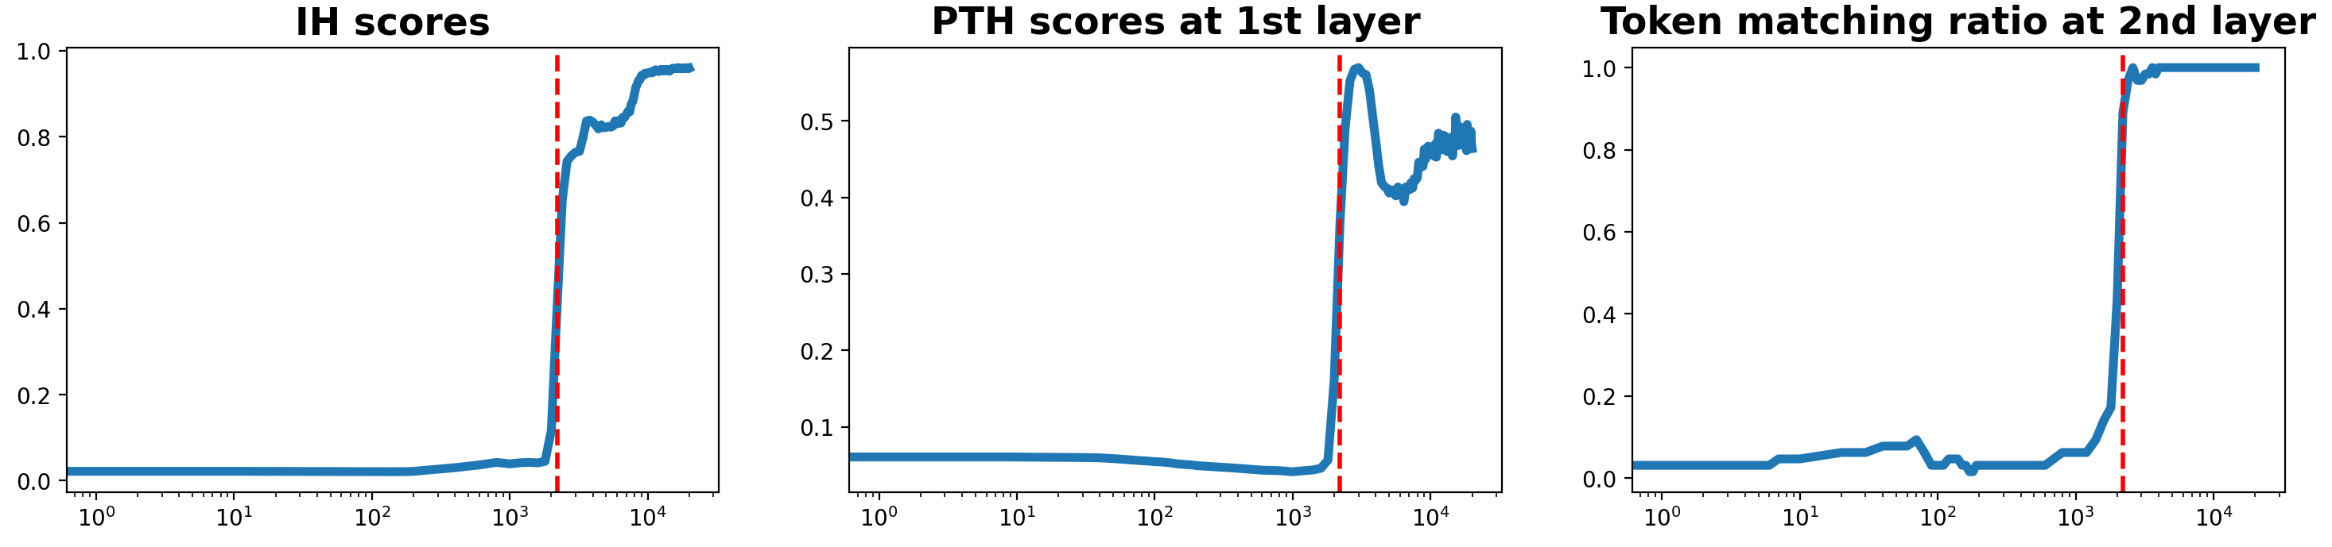
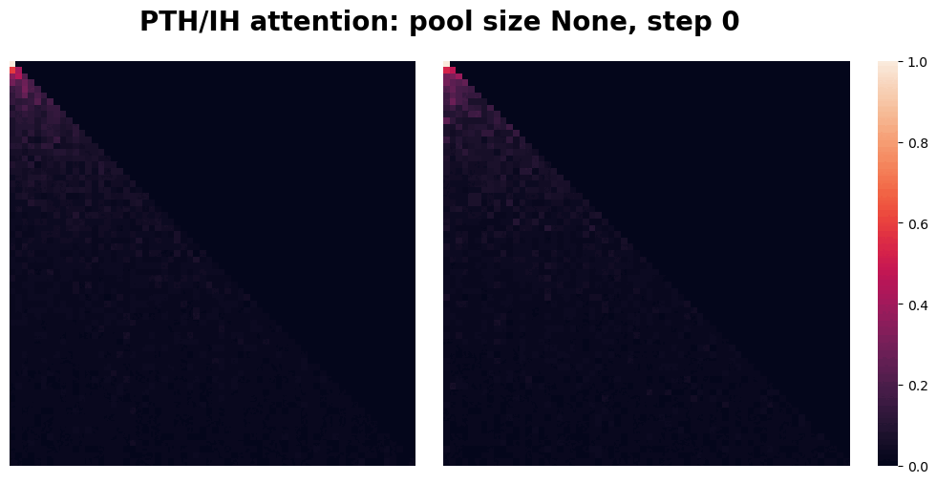
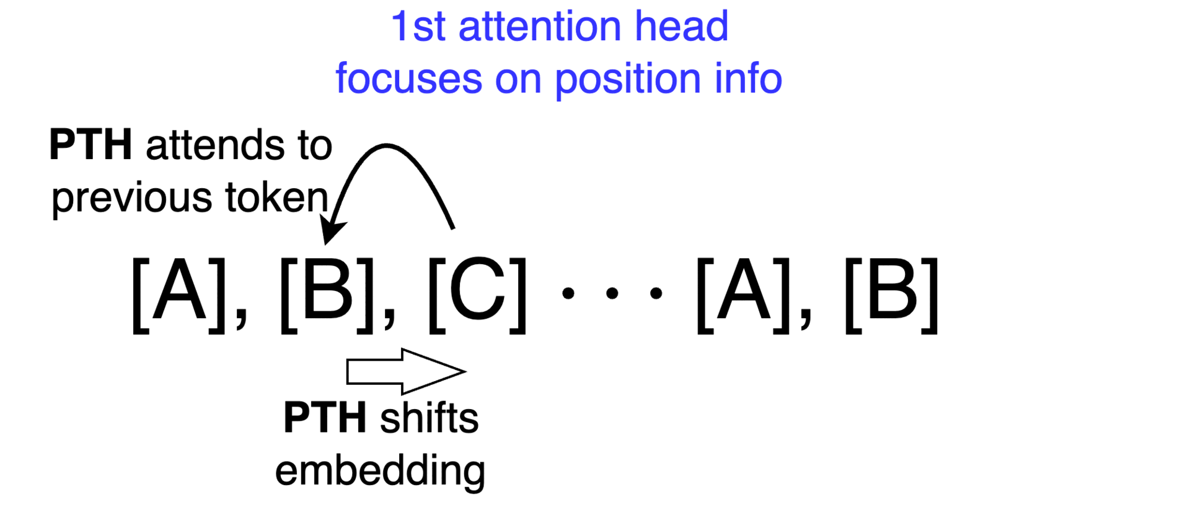

Slide 23
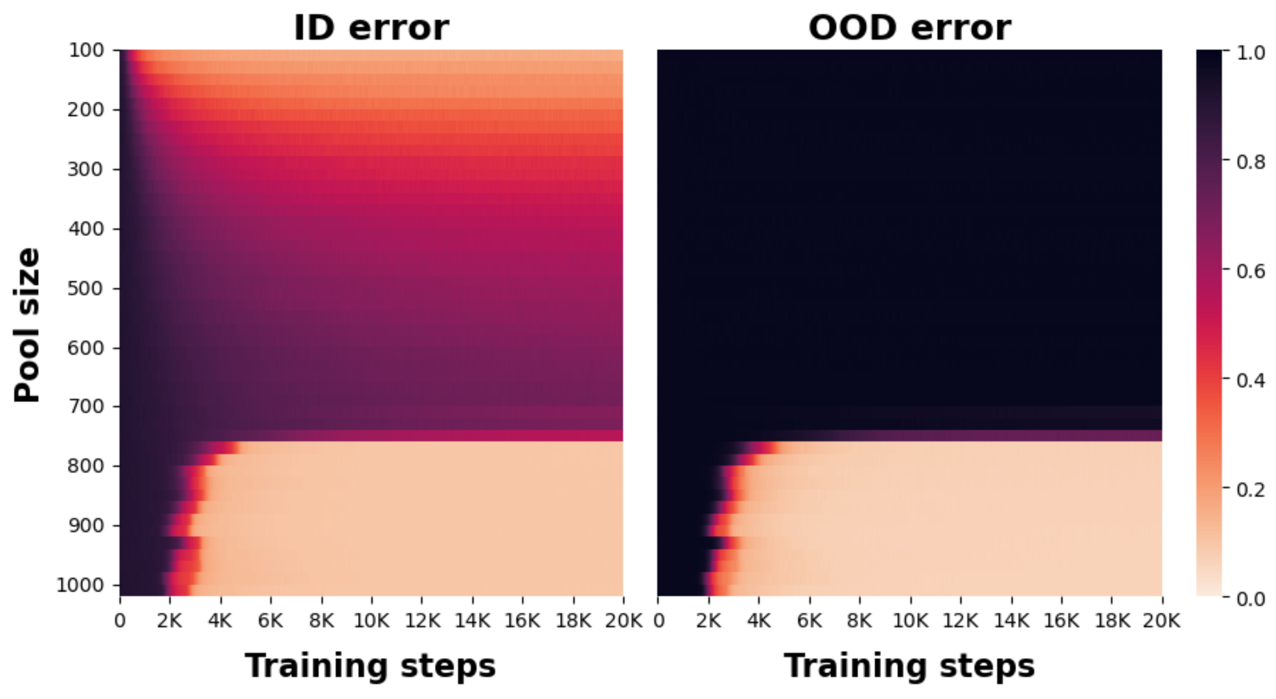
Subspace matching: First layer “writing circuit” (OV) matches second layer “reading circuit” (QK)
Complementary roles: first layer focuses on positional info, second layer token info
Clear phase transition: critical thresholds in both diversity and training steps

Slide 24
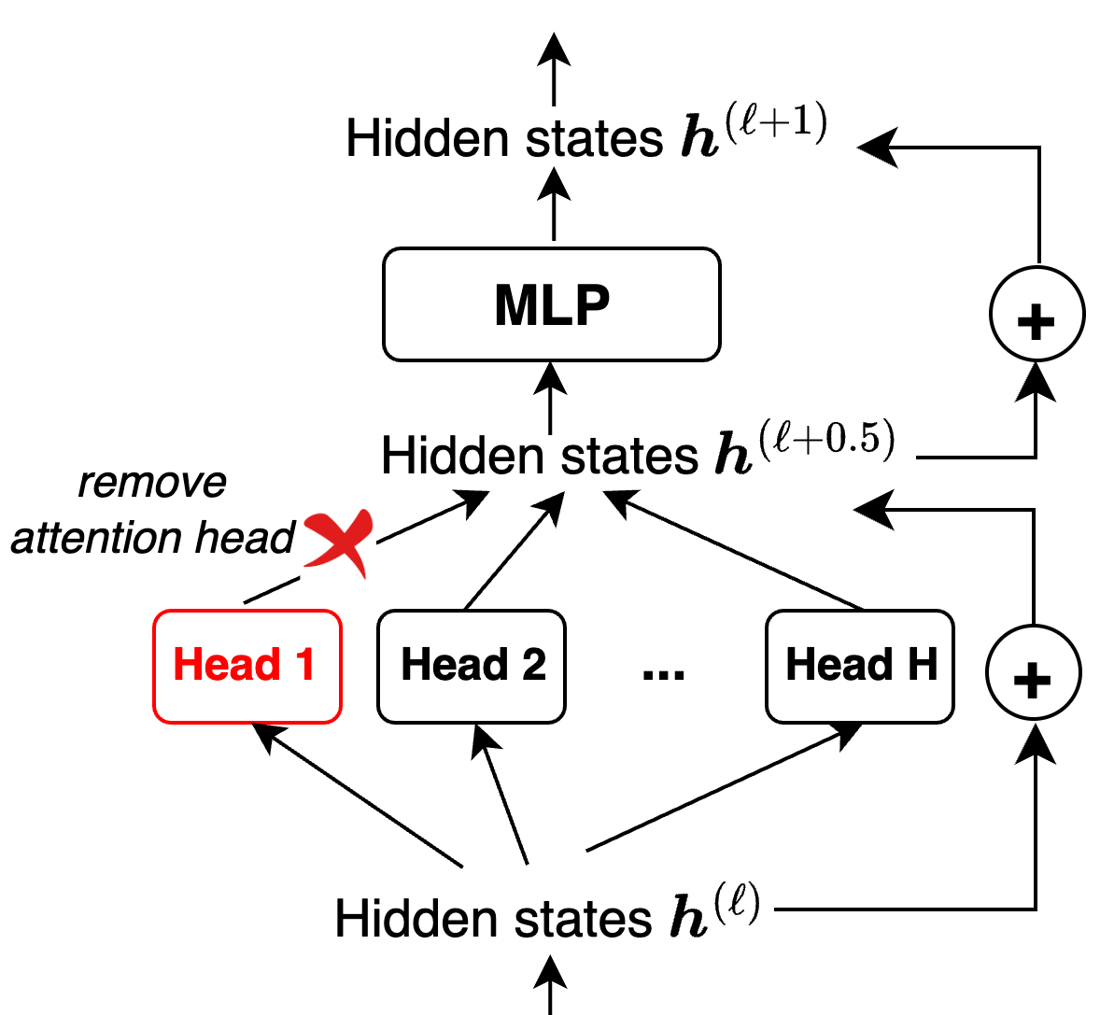
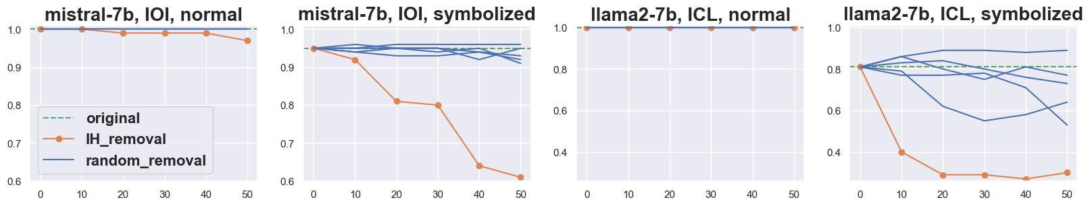
LLM experiment “Symbolized language reasoning”
Many attention heads in LLMs (even GPT2-small has 12*12 heads)
Ranking heads and screen top ~50 as induction heads

Slide 25
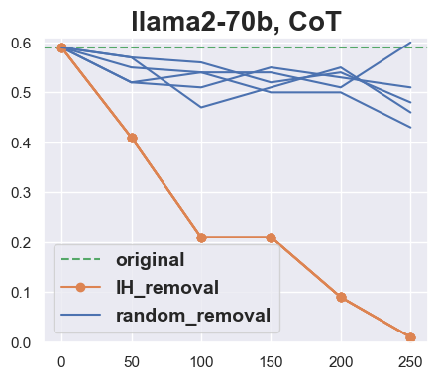
OOD generalization depends crucially on IHs
LLMs on normal prompts are insensitive to IH removal (memorization)
In contrast, LLMs on symbolized (OOD) prompts depend on IHs
Same crucial dependence for CoT on GSM8K

Slide 26
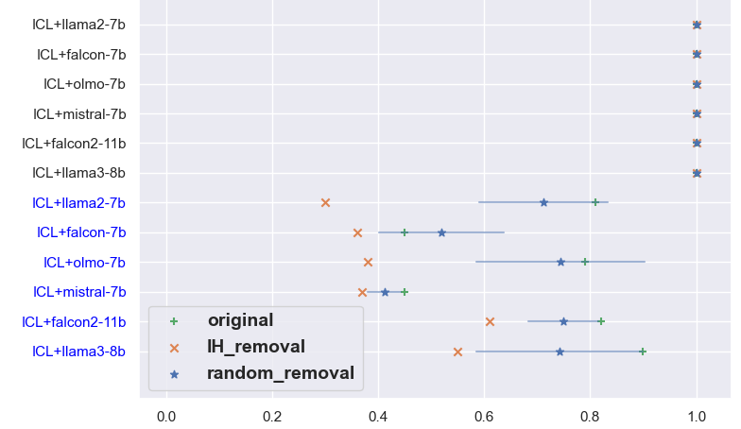
OOD generalization depends crucially on IHs

Slide 27
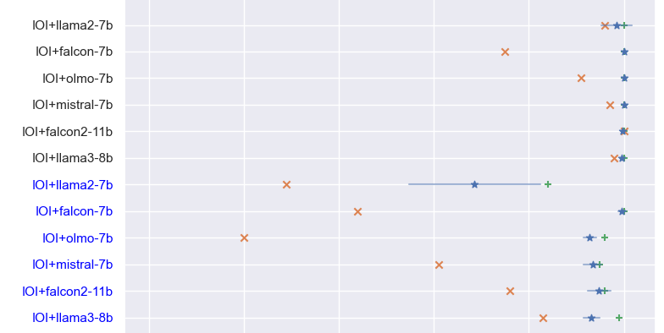
OOD generalization depends crucially on IHs

Slide 28
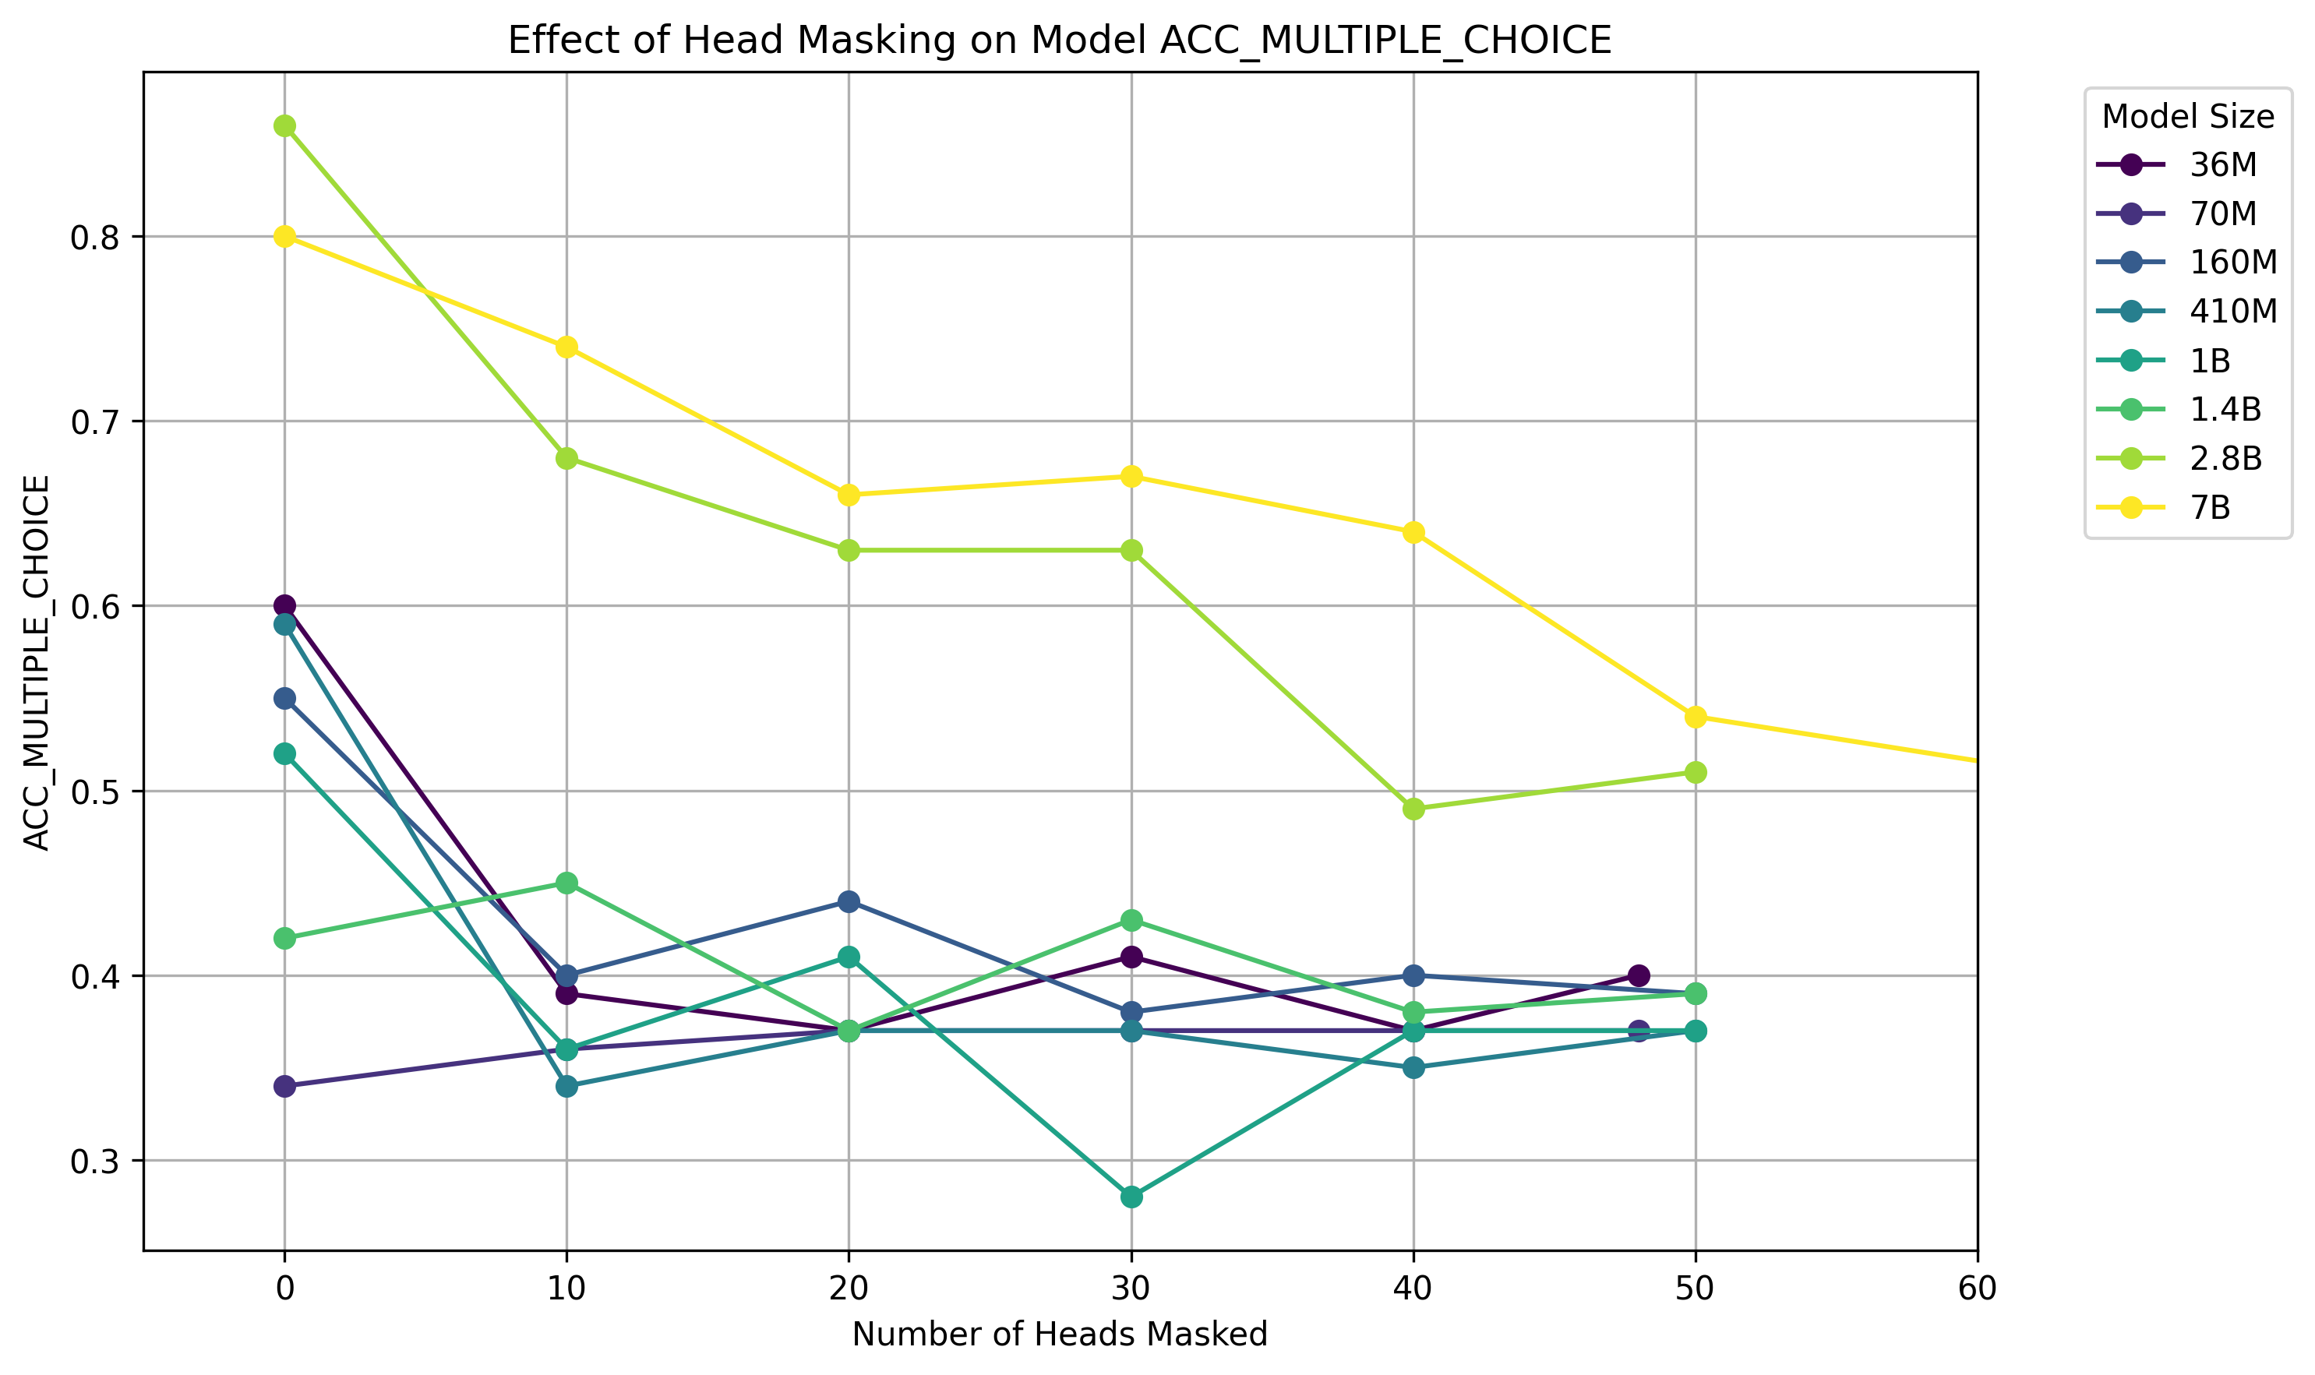
OOD generalization depends crucially on IHs: scaling experiments

Slide 29
Common Subspace Representation Hypothesis

Slide 30
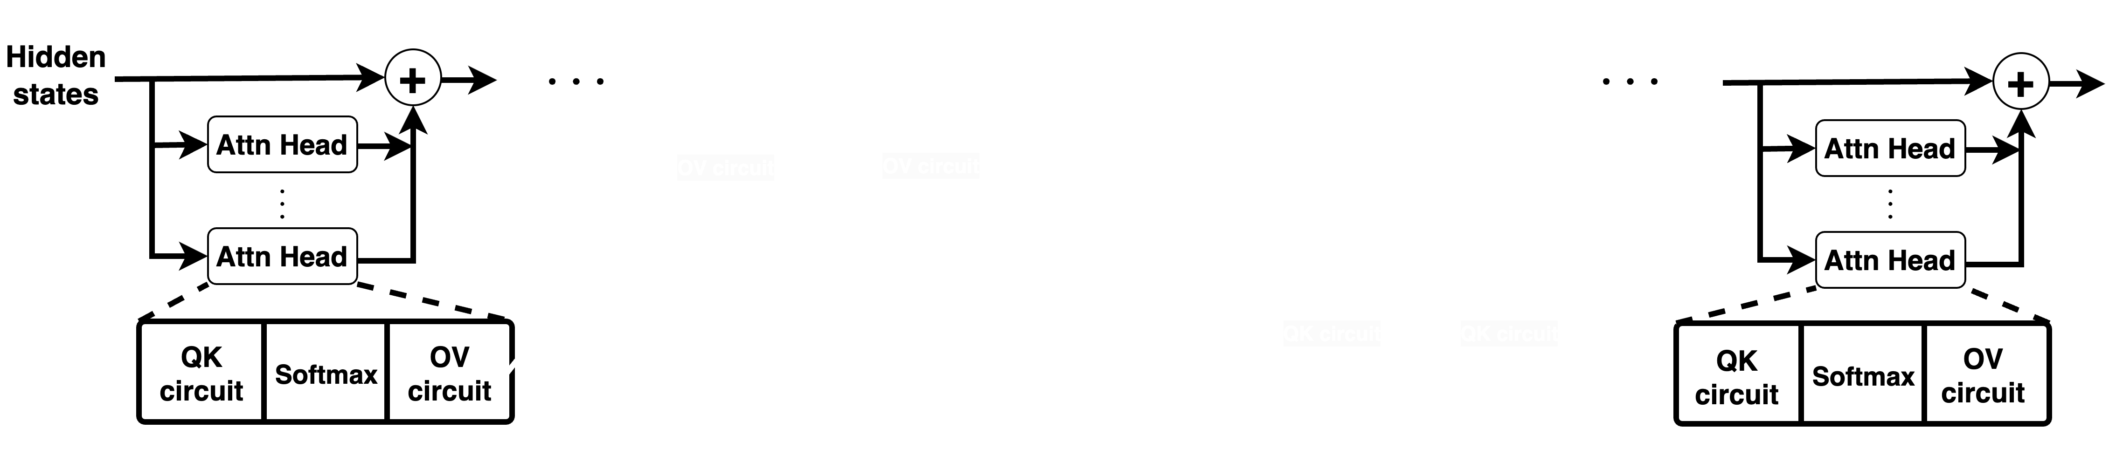
How subspace matching works in LLMs
Multi-layer, multi-head, how do two layers match?
Generalizes the linear representation hypothesis

Slide 31
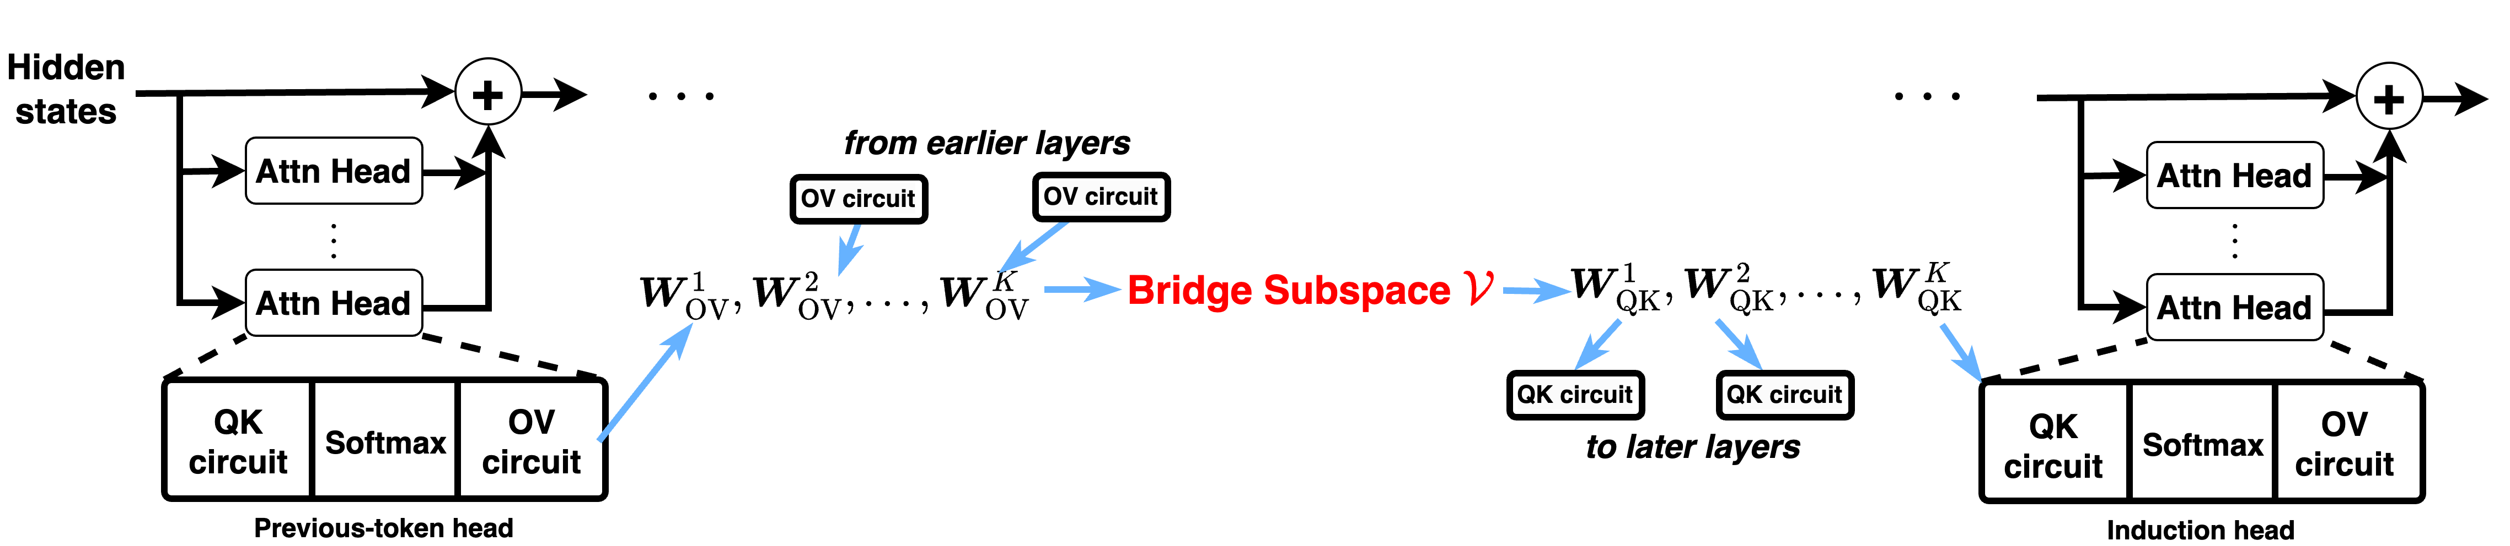
How subspace matching works in LLMs
Multi-layer, multi-head, how do two layers match?
Generalizes the linear representation hypothesis
Bridge subspace in ideal form

Slide 32
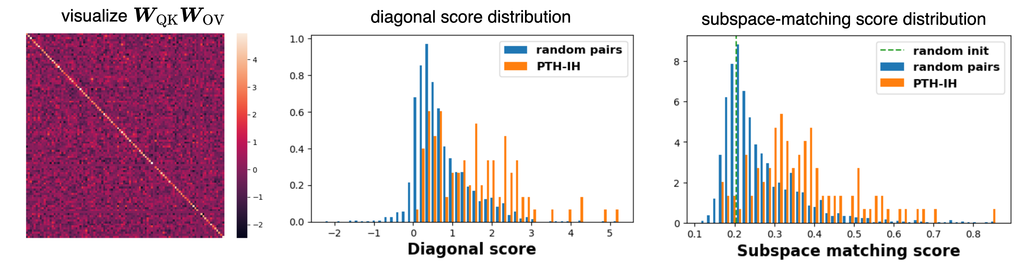
Pairwise matching suggests shared global structure
GPT-2 on copying task
Strong pairwise matching among top-ranked PTHs and IHs

Slide 33
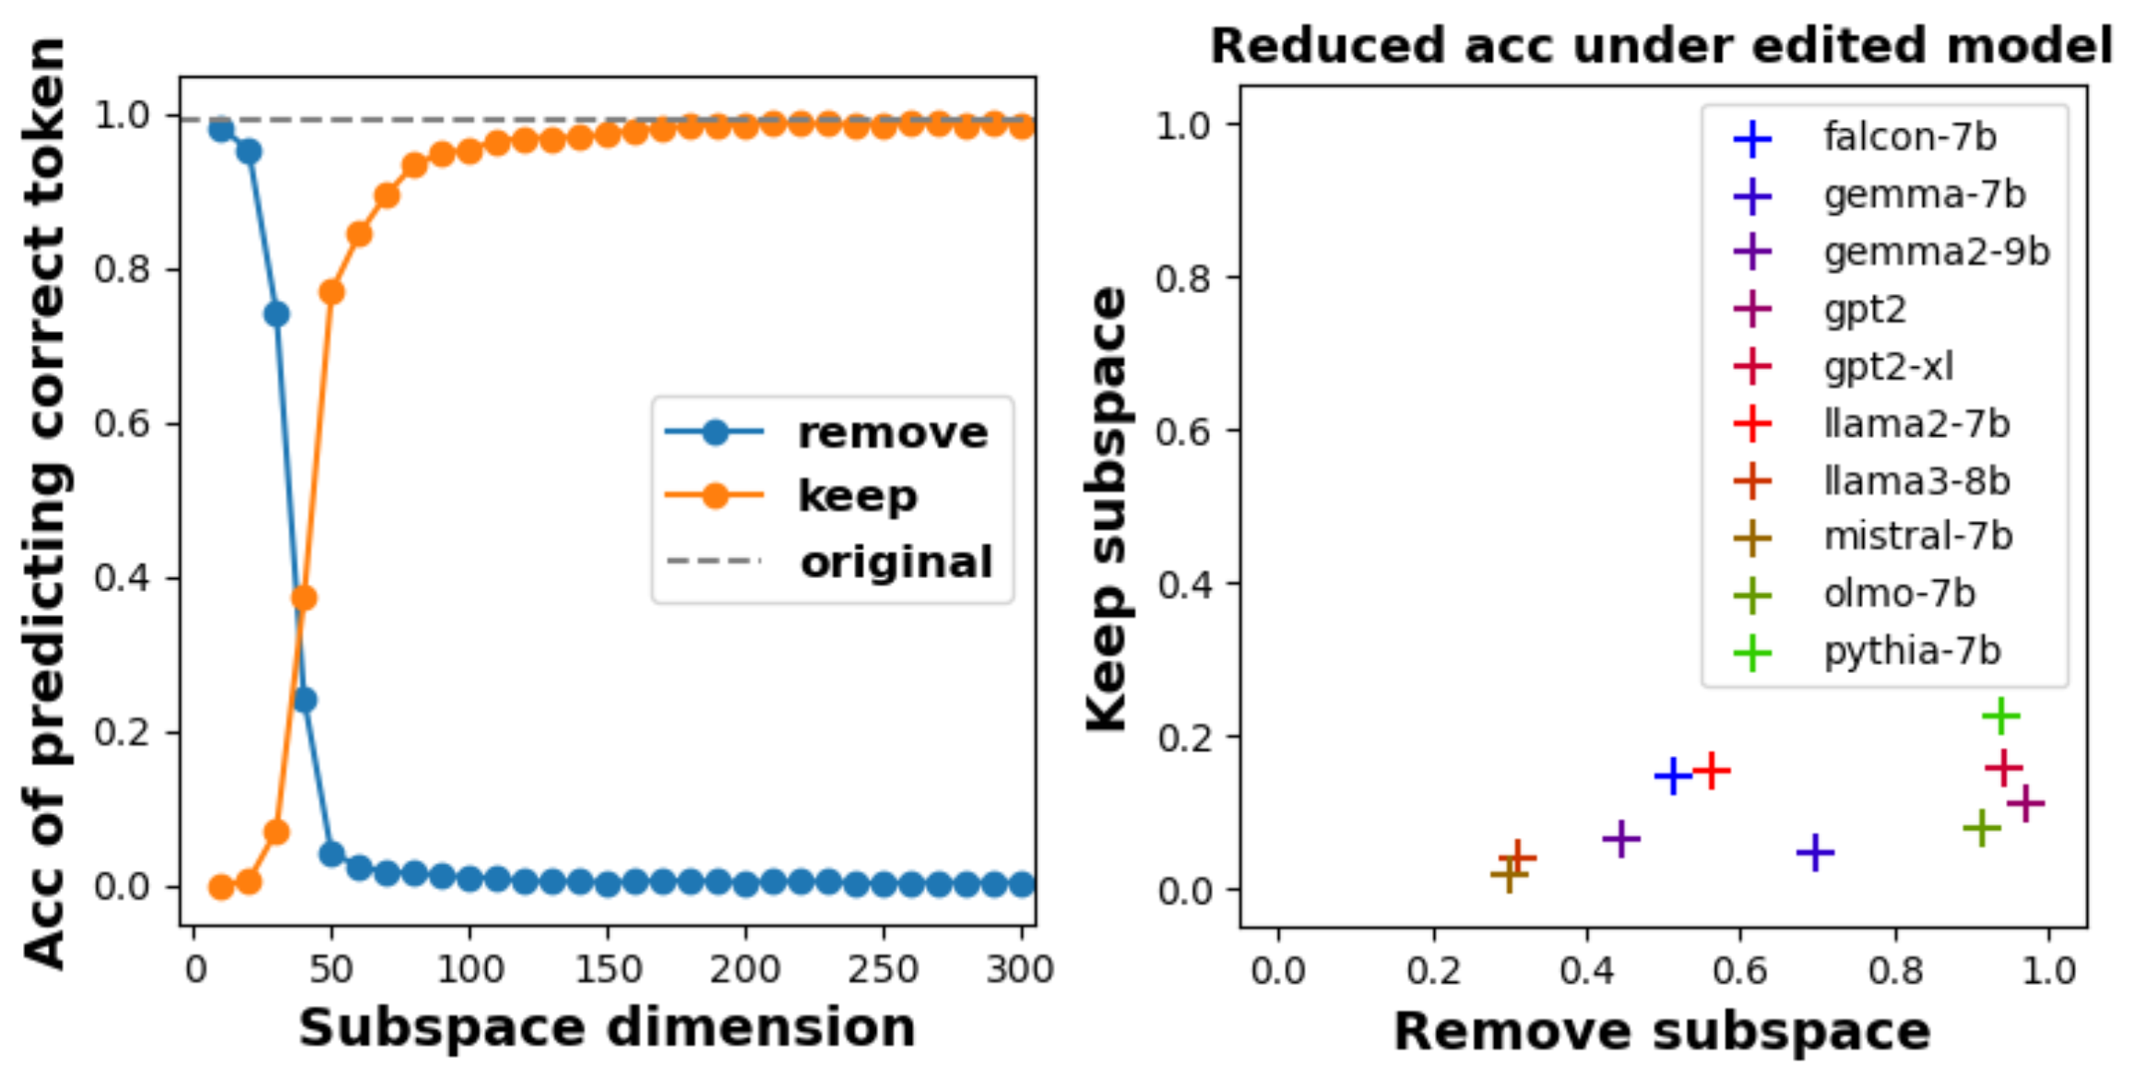
Impact of removing bridge subspace
Left: GPT-2, Right: various LLMs
Calculate bridge subspace by pooled SVD:
Two projection applied to weight matrices

Slide 34
(Speculative) take-away messages

Slide 35
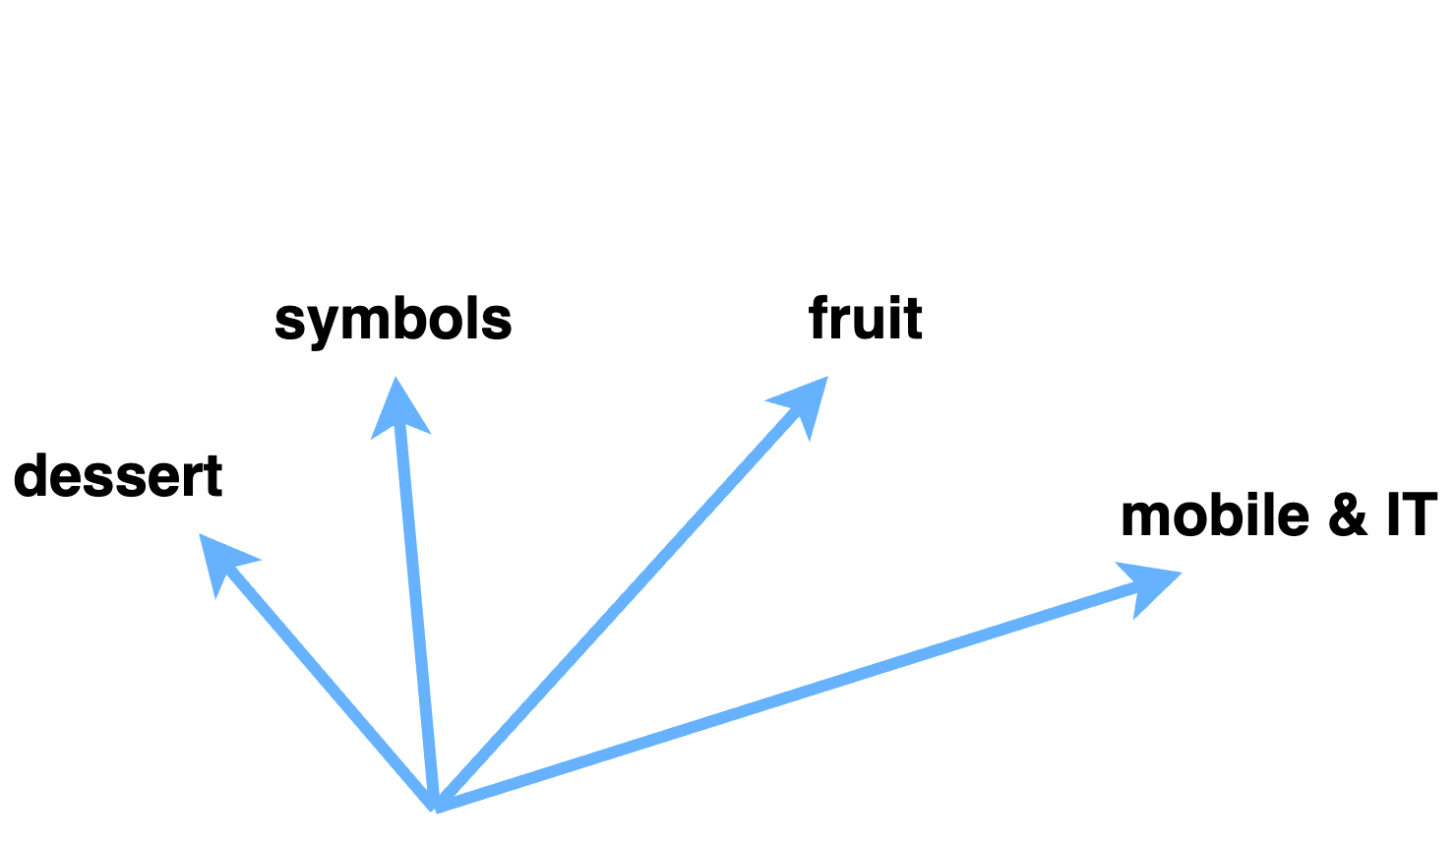
What do hidden states really represent
Concept subspaces

Slide 36
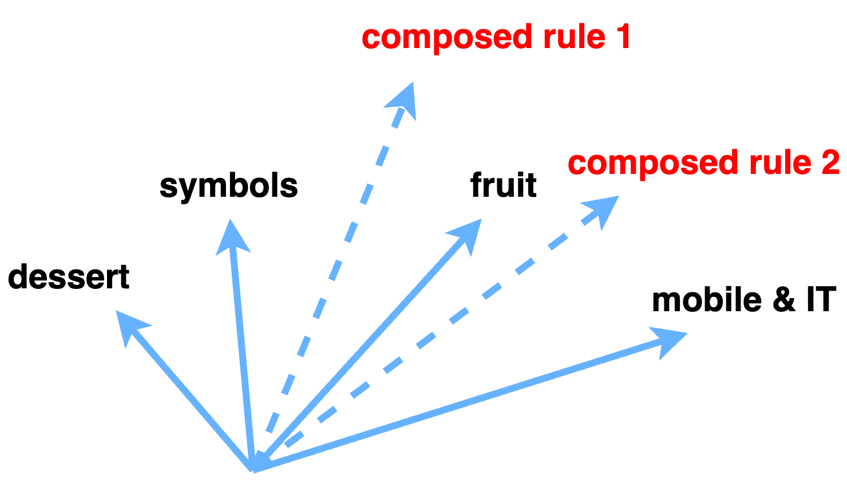
What do hidden states really represent
Concept subspaces + rule subspaces
Composed rule 1 (e.g., copying), composed rule 2 …
Enables OOD generalization, esp. in novel context (ICL, CoT)

Slide 37
Thank you!

Slide 38
References
Trevor Hastie, Robert Tibshirani, Jerome H. Friedman, and Jerome H. Friedman. The elements of statistical learning: data mining, inference, and prediction. Vol. 2. New York: Springer, 2009.
Mikhail Belkin, Daniel Hsu, Siyuan Ma, and Soumik Mandal. "Reconciling modern machine-learning practice and the classical bias–variance trade-off." Proceedings of the National Academy of Sciences 116, no. 32 (2019): 15849-15854.
Kevin Ro Wang, Alexandre Variengien, Arthur Conmy, Buck Shlegeris, and Jacob Steinhardt. Interpretability in the wild: a circuit for indirect object identification in GPT-2 small. In The Eleventh International Conference on Learning Representations, 2023.
Frieda Rong. Extrapolating to unnatural language processing with gpt-3’s in-context learning: The good, the bad, and the mysterious, 2021.
Nelson Elhage, Neel Nanda, Catherine Olsson, Tom Henighan, Nicholas Joseph, Ben Mann, Amanda Askell, Yuntao Bai, Anna Chen, Tom Conerly, Nova DasSarma, Dawn Drain, Deep Ganguli, Zac Hatfield-Dodds, Danny Hernandez, Andy Jones, Jackson Kernion, Liane Lovitt, Kamal Ndousse, Dario Amodei, Tom Brown, Jack Clark, Jared Kaplan, Sam McCandlish, and Chris Olah. A mathematical framework for transformer circuits. Transformer Circuits Thread, 2021. https://transformer-circuits.pub/2021/framework/index.html

Slide 39
References
Catherine Olsson, Nelson Elhage, Neel Nanda, Nicholas Joseph, Nova DasSarma, Tom Henighan, Ben Mann, Amanda Askell, Yuntao Bai, Anna Chen, Tom Conerly, Dawn Drain, Deep Ganguli, Zac Hatfield-Dodds, Danny Hernandez, Scott Johnston, Andy Jones, Jackson Kernion, Liane Lovitt, Kamal Ndousse, Dario Amodei, Tom Brown, Jack Clark, Jared Kaplan, Sam McCandlish, and Chris Olah. In-context learning and induction heads. Transformer Circuits Thread, 2022. https://transformer-circuits.pub/2022/in-context-learning-and-induction-heads/index.html.
Tomáš Mikolov, Wen-tau Yih, and Geoffrey Zweig. "Linguistic regularities in continuous space word representations." Proceedings of the 2013 conference of the north american chapter of the association for computational linguistics: Human language technologies. 2013.
Abbe, Emmanuel, Samy Bengio, Aryo Lotfi, and Kevin Rizk. "Generalization on the unseen, logic reasoning and degree curriculum." In International Conference on Machine Learning, pp. 31-60. PMLR, 2023.
Rheeya Uppaal, Apratim Dey, Yiting He, Yiqiao Zhong, Junjie Hu, “Model Editing as a Robust and Denoised variant of DPO: A Case Study on Toxicity”, 2024
Pan, Jane, Tianyu Gao, Howard Chen, and Danqi Chen. "What In-Context Learning" Learns" In-Context: Disentangling Task Recognition and Task Learning." In The 61st Annual Meeting Of The Association For Computational Linguistics. 2023.

